Slide 1
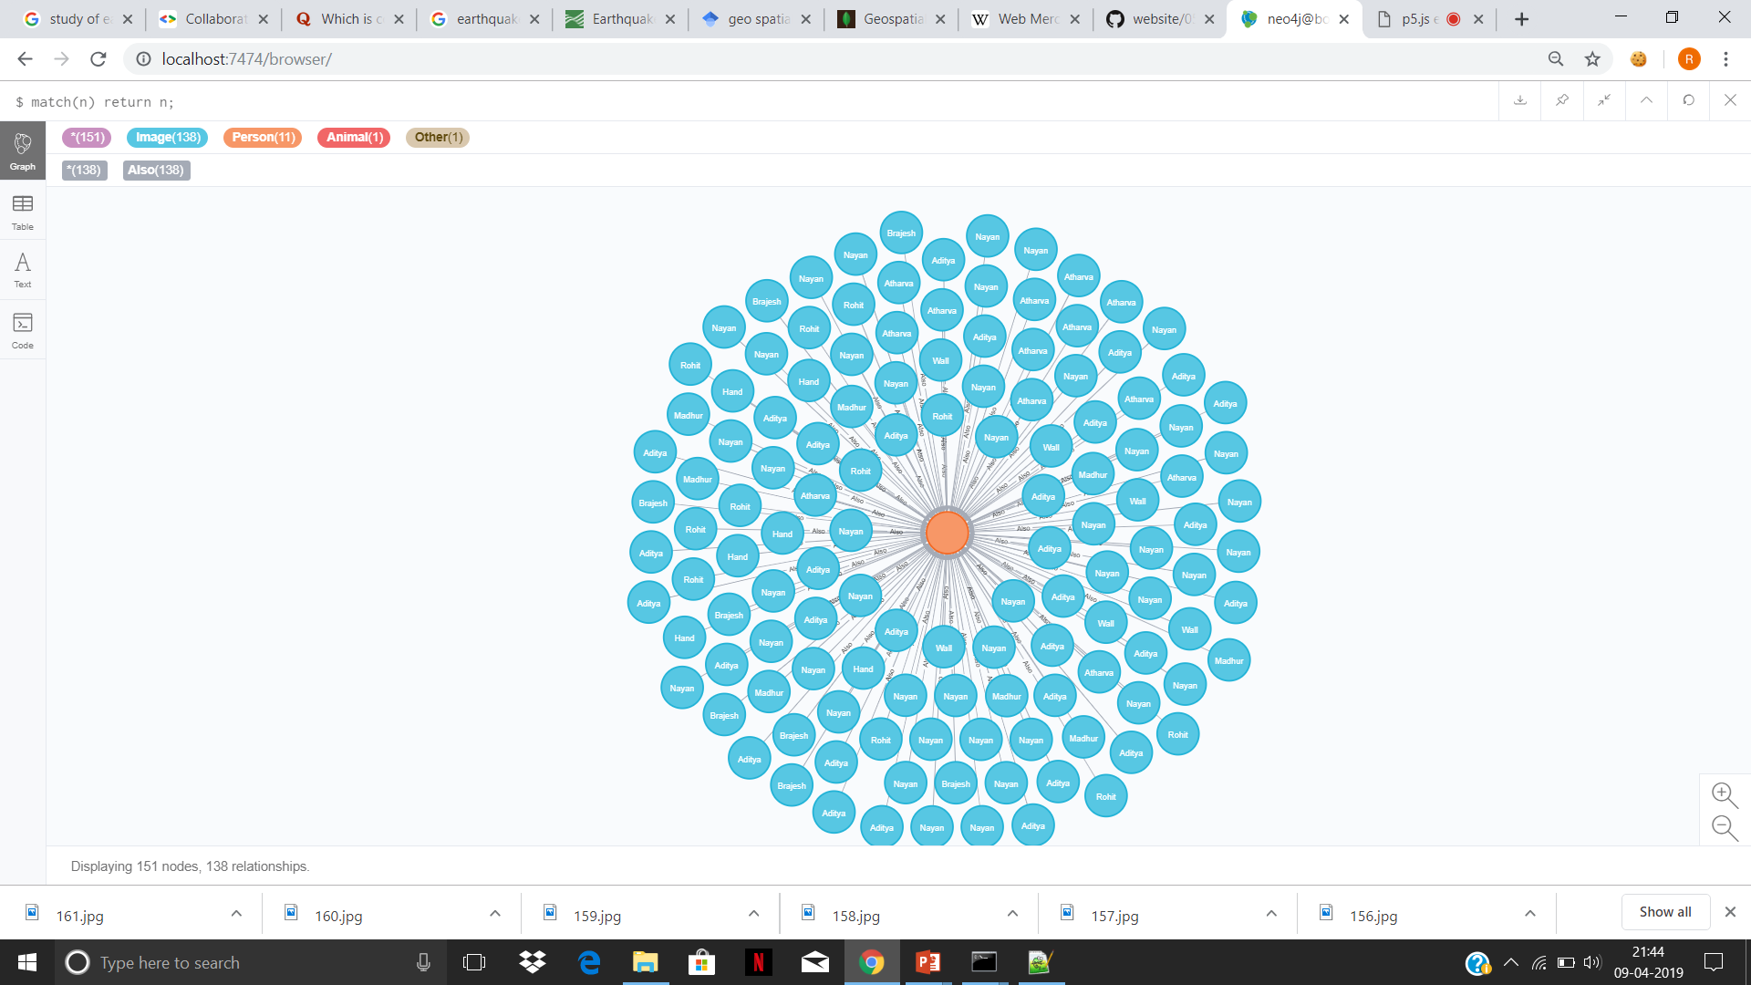

Slide 2
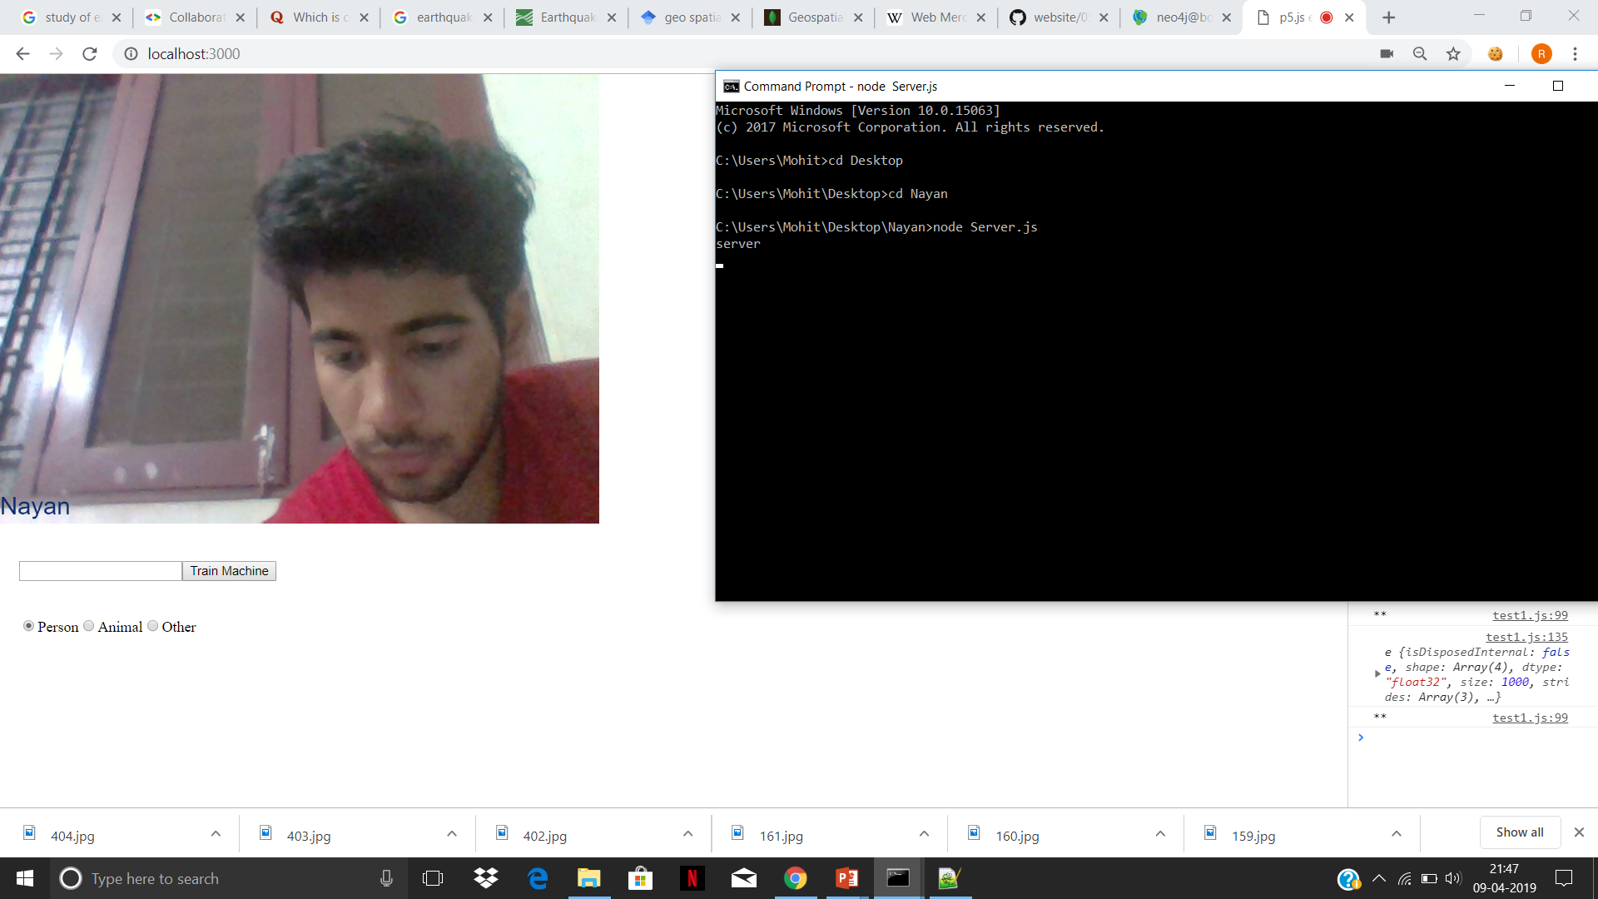

Slide 3
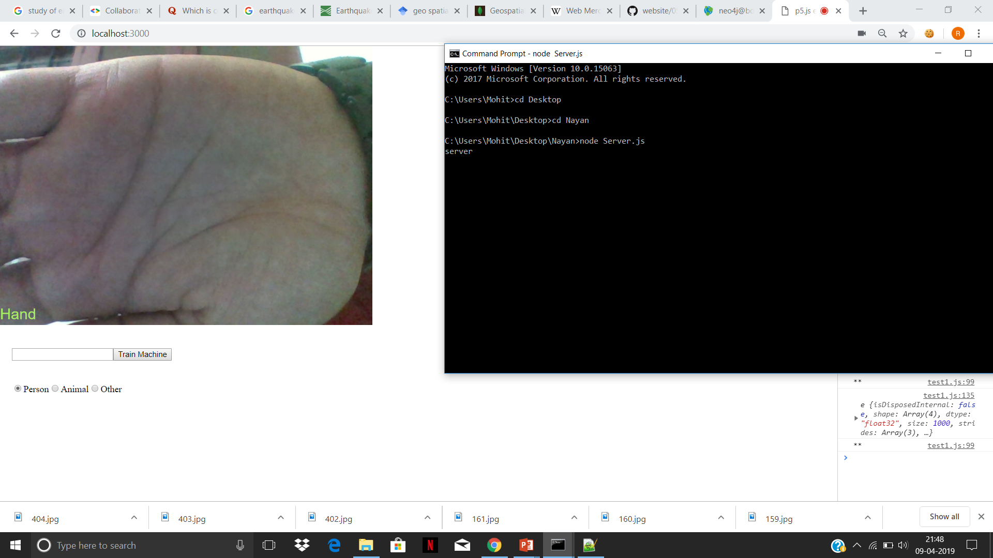

Slide 4
https://www.youtube.com/user/shiffman

Slide 5
Conclusion
Seismologists can explore organized earthquakes data.
Notes:
Seismologists study organized earthquakes data

